Slide 1
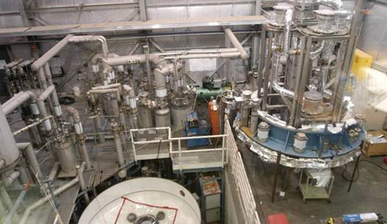
SAF 130C
PRESSURE AND VACUUM SYSTEM OWNER TRAINING

Slide 2
COURSE OVERVIEW
Introduction: Why Are We Here?
“Anatomy of a Disaster”
Safe Operation Techniques
Maintenance or Repair?
Safe Maintenance Techniques
Maintenance Lessons Learned
In-service Inspection Program
Wrap up / Where to Get Help

Slide 3
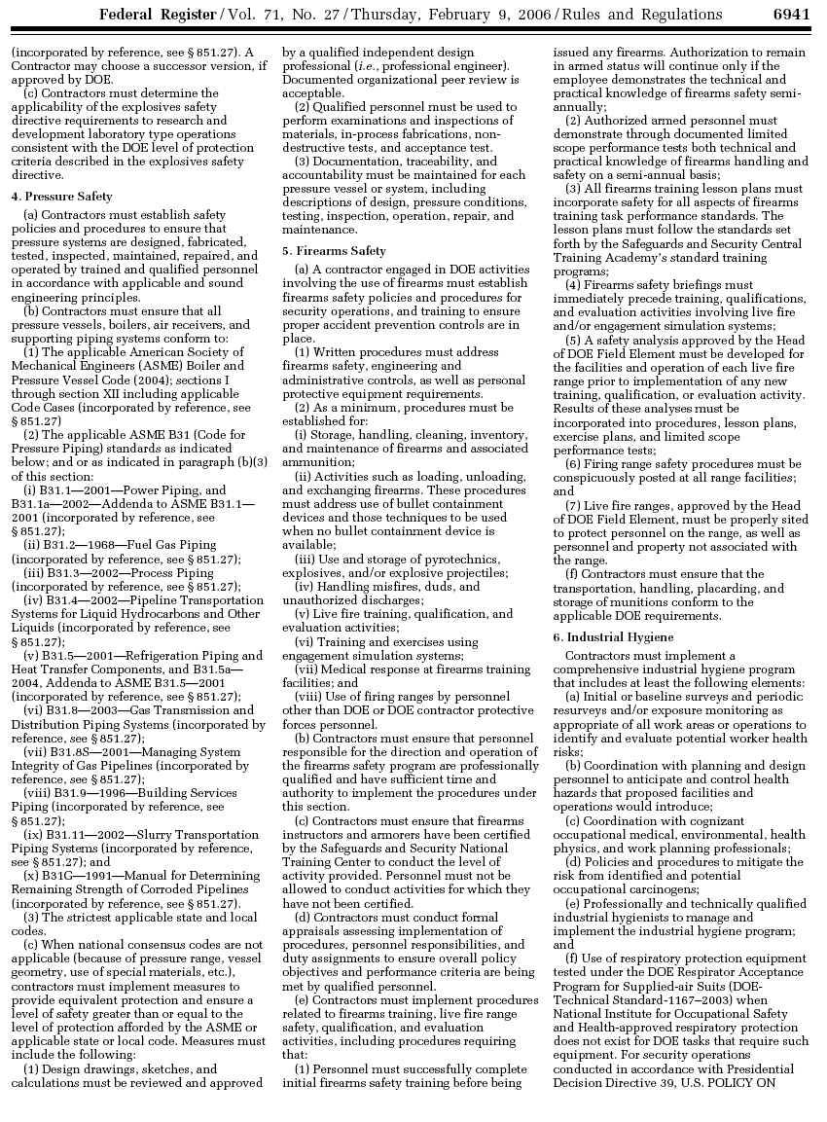
Introduction: Why Are We Here?
“Contractors must establish safety policies and procedures to ensure that pressure systems are designed, fabricated, tested, inspected, maintained, repaired, and operated by trained and qualified personnel in accordance with applicable and sound engineering principles.”
“Contractors must establish safety policies and procedures to ensure that pressure systems are designed, fabricated, tested, inspected, maintained, repaired, and operated by trained and qualified personnel in accordance with applicable and sound engineering principles.”
“Contractors must ensure that all pressure vessels … and supporting piping systems conform to:
(1) The applicable ASME Boiler and Pressure Vessel Code
(2) The applicable ASME B31 Code for Pressure Piping
(3) The strictest applicable state and local codes”
10CFR851 has always imposed requirements on post-construction.
Our new program includes a more structured approach to how we define post-construction “applicable and sound engineering principles”.
“System Owner” is now identified.
Post-construction references used are:
API 521 Guide for Pressure-relieving and Depressuring Systems
API 576 Inspection of Pressure Relieving Devices
National Board Inspection Code (NBIC)/NB23
Part1: Rules for Installation
Part 2: Rules for Inspection
Part 3: Rules for Repair and Alteration
ASME PCC-1 Guidelines for Pressure Boundary Bolted Flange Joint Assembly
ASME PCC-2 Repair of Pressure Equipment and Piping
“When national consensus codes are not applicable (because of pressure range, vessel geometry, use of special material, etc.), contractors must implement measures to provide equivalent protection…”

Slide 4
Introduction: Why Are We Here?
Hazard Avoidance Techniques from SAF130A
design, fabricate, test according to ASME or other Code
operate within design parameters
use only for designed purpose
do not apply heat unless specifically authorized
do not work on systems without authorization and training
perform maintenance, report damage or defects
use Lock, Tag, Try to depressurize/repressurize
perform routine in-service inspections

Slide 5
Introduction: Why Are We Here?
Hazard Avoidance Techniques from SAF130A
design, fabricate, test according to ASME or other Code
Design Authority
operate within design parameters
System Owner
use only for designed purpose
System Owner
System Owner may delegate tasks but not responsibility
do not apply heat unless specifically authorized
System Owner
do not work on systems without authorization and training
System Owner
perform maintenance, report damage or defects
System Owner
use Lock, Tag, Try to depressurize/repressurize
System Owner
perform routine in-service inspections
System Owner

Slide 6
COURSE OVERVIEW
Introduction: Why Are We Here?
“Anatomy of a Disaster”
Safe Operation Techniques
Maintenance or Repair?
Safe Maintenance Techniques
Maintenance Lessons Learned
In-service Inspection Program
Wrap up / Where to Get Help

Slide 7
“Anatomy of a Disaster”
A film produced by the
U.S. Chemical Safety and Hazard Investigation Board
detailing the sequence of events and causes of the
Texas City Refinery Explosion on March 23, 2005

Slide 8
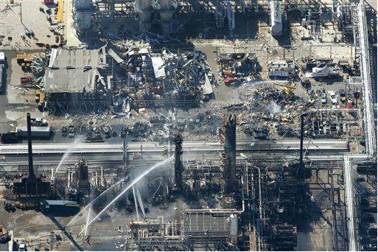
“Anatomy of a Disaster”

Slide 9
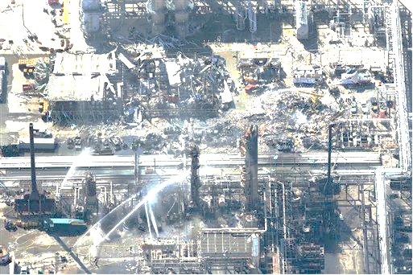
“Anatomy of a Disaster”
“…years in the making but it was by no means inevitable”
Personal vs Process Safety
Reporting Events and Making Corrective Actions
Antiquated Designs
Siting of Employees
Human Factors
Not following procedures
Instrumentation not correct
Miscommunication
Poor training
Staffing limitations
Employee fatigue

Slide 10
COURSE OVERVIEW
Introduction: Why Are We Here?
“Anatomy of a Disaster”
Safe Operation Techniques
Maintenance or Repair?
Safe Maintenance Techniques
Maintenance Lessons Learned
In-service Inspection Program
Wrap up / Where to Get Help

Slide 11
Safe Operation Techniques
Know operating conditions
Identify inherent hazards
Describe failure scenarios and deployment of emergency protocols
Verify valve position
Monitor and maintain operating parameters with installed instrumentation
Develop operating instructions (normal and emergency)
Check for Leaks, Degradation, Corrosion, Blockages
Train operators to all of the above
Complete and store required documentation

Slide 12
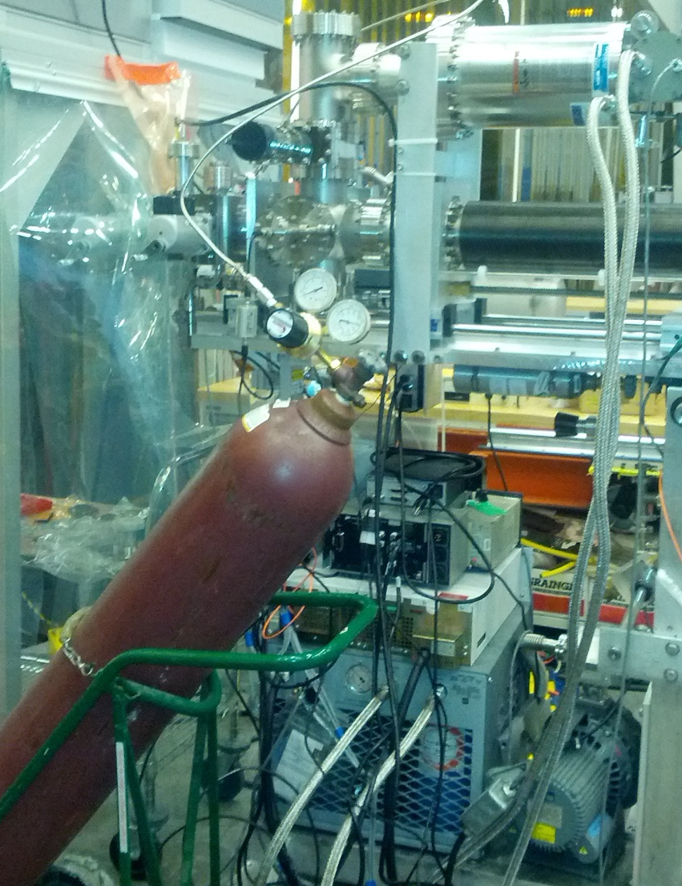
Connecting a gas or liquefied gas cylinder to piping or a vessel creates a pressure system!
Follow ES&H Manual Chapter 6150 for the gas bottle and Chapter 6151 for connected piping systems. GET A DA INVOLVED!
Anyone working with the connected pressure system must be appropriately trained and perform work in a safe manner.

Slide 13
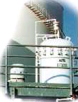
Safe Operation Techniques: Know the Operating Conditions
Safe Operation Techniques:
Safe Operation Techniques: Know and Understand the Operating Conditions
Know the liquid or gas being contained.
Know the pressures and temperatures for normal operation.
Understand the safe operating limits of the system and any equipment directly linked to or affected by it.
Safe Operating Limits
Depend on complexity and operating conditions:
Simple systems may only need maximum pressure.
Complex systems might need min/max pressures and temperatures, volumes and flow rates, operating times, heat input or coolant flow.
In all cases, safe operating limits should incorporate a suitable margin of safety.
Provided by Manufacturers for standard production items
Determined by the Design Authority for new systems.
For existing systems, defined by System Owner using historical information and assistance if needed

Slide 14
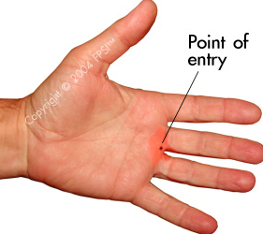
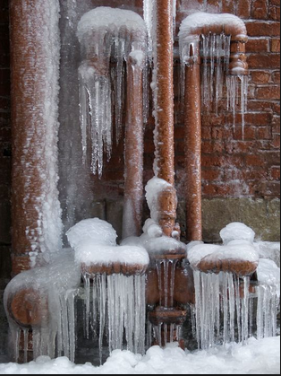
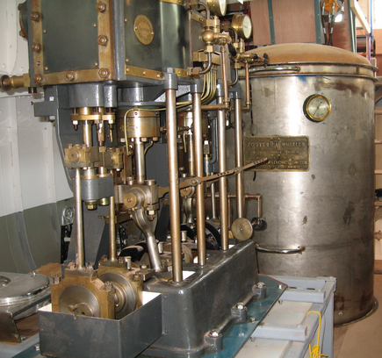
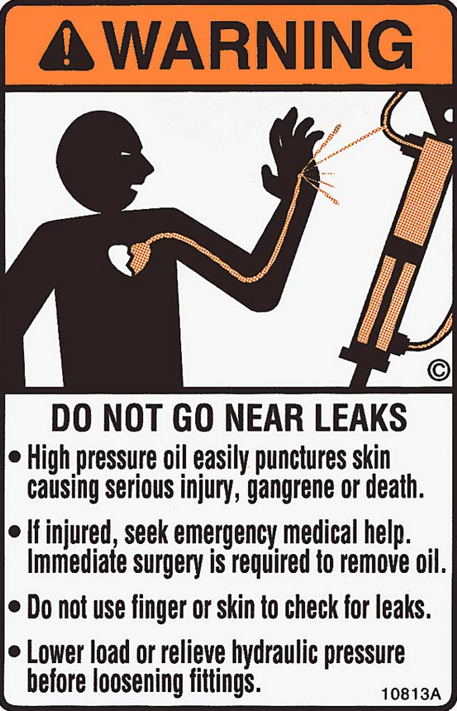
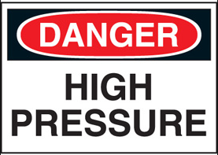
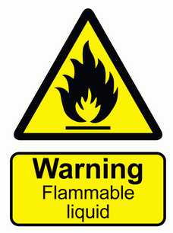
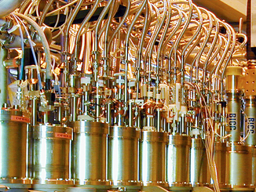
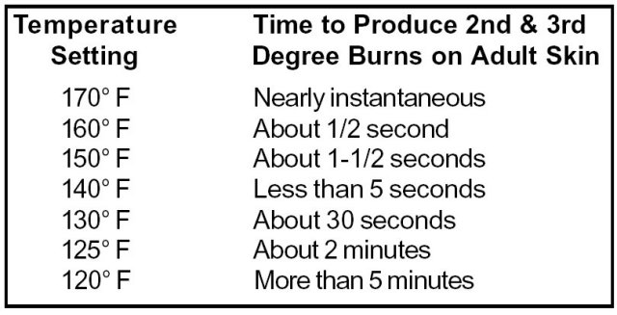
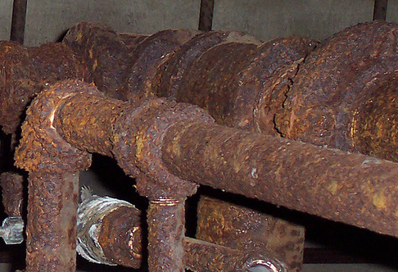
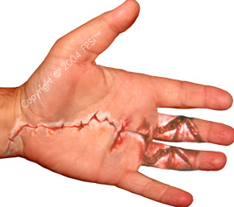
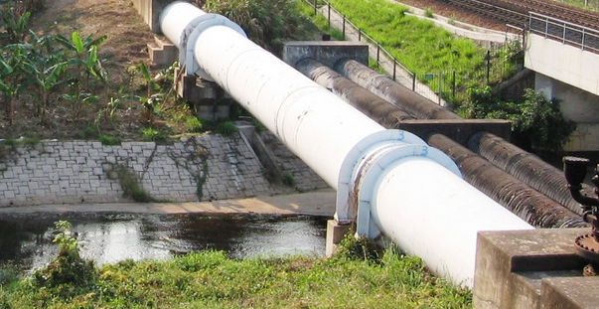
Identify the Inherent Hazards
Safe Operation Techniques:
A high pressure oil injection injury might look innocuous…
Dangers of Hot Water
Is the liquid or gas being contained flammable or dangerous?
Are the operating pressures and temperatures dangerous?
Do age and condition increase hazards?
Do environmental factors create hazards?
Are the complexity and control of operation contributing factors?
Consult the ESH Manual Chapters on Industrial Hygiene, MSDS’s and Flammable Gas Supplement
High Pressure Oil
…but the damage is insidious and can be life threatening

Slide 15
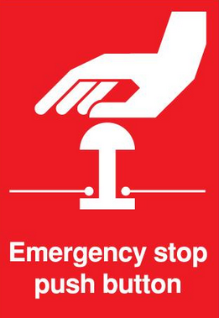
Failure Scenarios and Emergency Protocols
Safe Operation Techniques:
Overpressure/Underpressure Failure can be caused by:
Operator error
Closed outlets / Blockages
Cooling failure
Entrance of volatile material
Overfilling
Failure of automatic controls
Abnormal heat input
Transient pressure surges
Chemical reactions
Hydraulic expansion
Fires
Utility failure
Inappropriate maintenance/repair

Slide 16
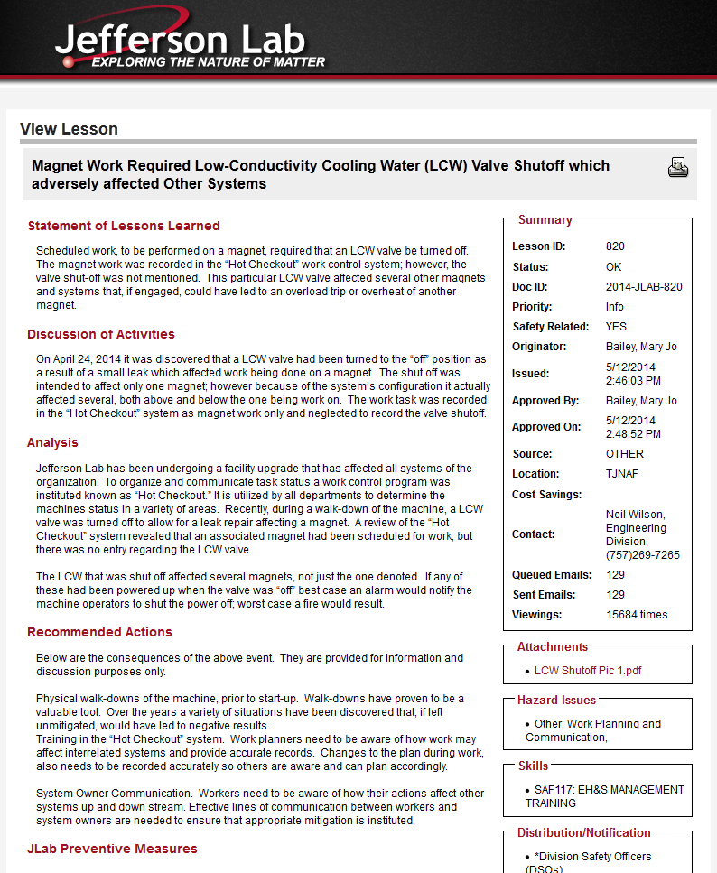
Verify Valve Position
Safe Operation Techniques:
“On April 24, 2014 it was
discovered that a LCW valve had been turned to the “off” position … the shut off was intended to affect only one magnet; however because of the system’s configuration it actually affected several …”
Check valve position for operation – Are all valves configured properly for startup and continued operation?
Check valve positions of connecting systems – does opening or closing a valve on a connected system affect your operation? Does opening or closing a valve on your system affect a connected system?
“If any of these had been powered up when the valve was “off” best case an alarm would notify the machine operators to shut the power off; worst case a fire would result.”

Slide 17
Monitoring with Installed Instrumentation
Safe Operation Techniques:
Is installed instrumentation adequate?
Sufficiency
Validity
Reliability
Is the instrumentation reading correctly? Some methods to verify:
Cross calibration
Demonstrate through proper operation of system
Calibrating controlling instruments on a regular basis and holding certificate on file (For example: a 3 year maximum interval is mandatory for ISO 9001)
Are the true operating conditions being displayed?

Slide 18
Safe Operation Techniques:
Develop Operating Instructions
Start-up and shutdown procedures
Precautions for standby operation
Function and effect of controls and protective devices
Likely fluctuations in normal operation
Overpressure protection is adequate at all times
Procedures in the event of an emergency
Design Authority defines operational requirements for new systems
System Owner develops operating instructions for new and existing systems

Slide 19
Safe Operation Techniques: Develop Operating Instructions
Operating procedures shall be developed to the extent deemed necessary for the safe and reliable operation of the system.

Slide 20
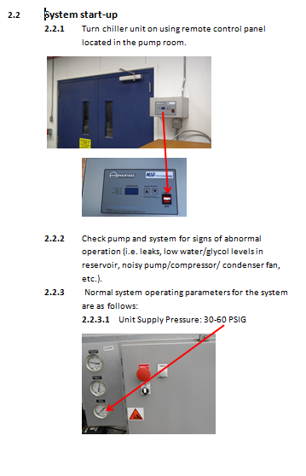
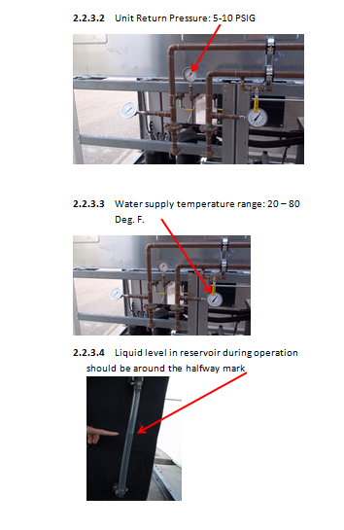
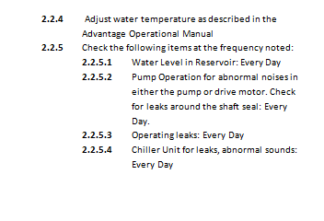
Safe Operation Techniques: Develop Operating Instructions
Example of simple instructions: HD Ice Chilled Water System

Slide 21
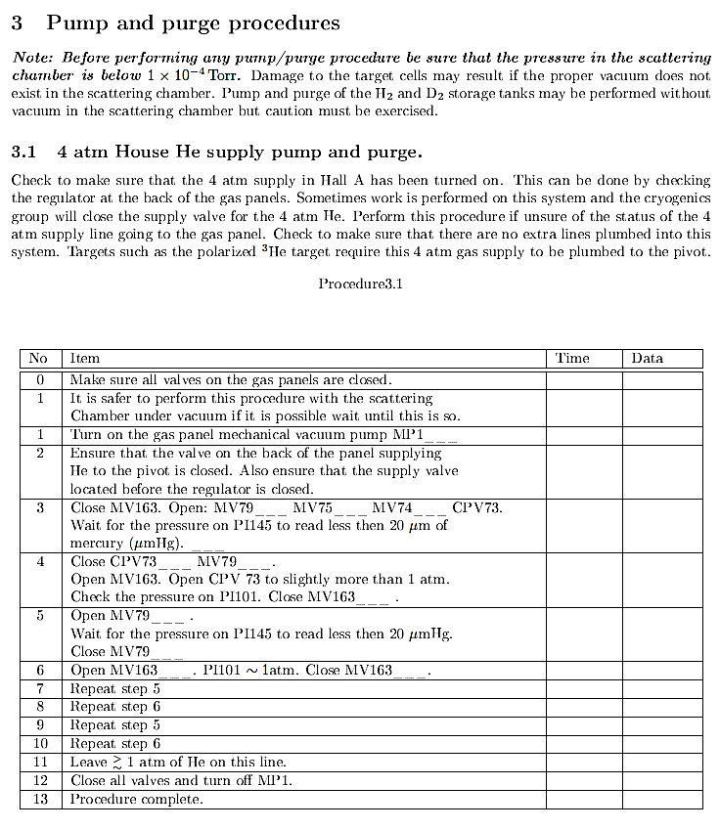
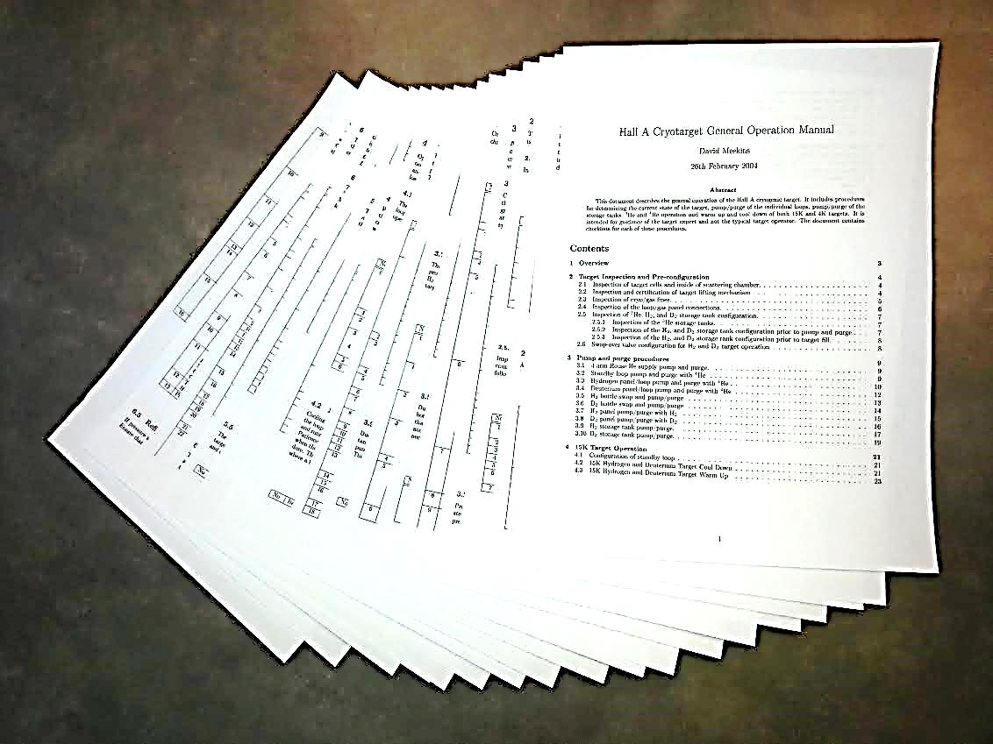
Safe Operation Techniques: Develop Operating Instructions
Example of detailed instructions: Hall A Cryotarget – 35 pages

Slide 22
Check for Leaks, Degradation, Corrosion, Blockages
Safe Operation Techniques:
Regularly check for tell-tale signs of problems and address them as soon as possible.
What is “regularly”?
What type of “check”?
Leaking flange might mean a new gasket is required / a leaky pipe section means a repair
A safety valve discharging repeatedly might mean it is malfunctioning or the system is unstable
Depends on the system parameters, age and location.
Minor corrosion can be cleaned, major corrosion with visual material loss points to a more serious situation
Visual of actual components, “reality check” of instrumentation read-outs.

Slide 23
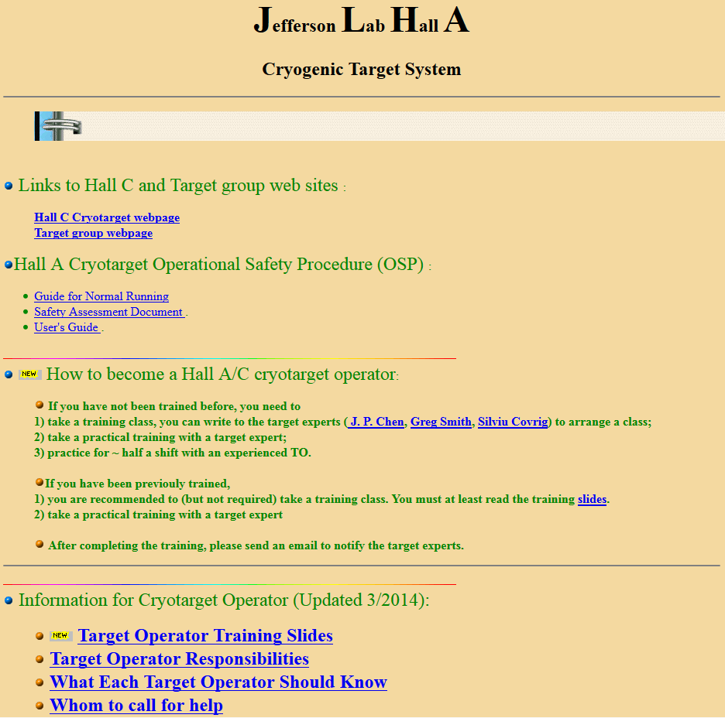
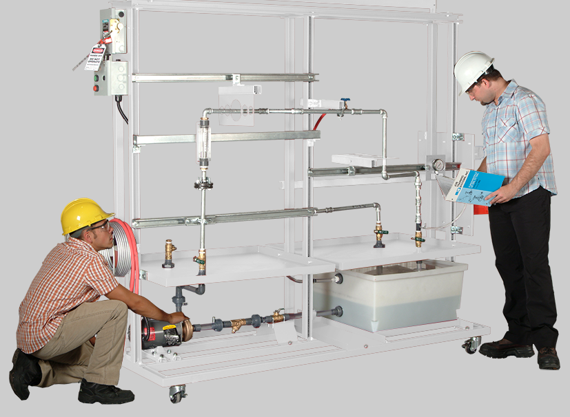
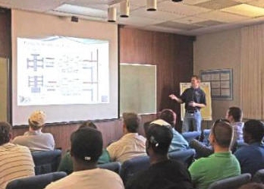
Safe Operation Techniques:
Training Your Operators
Operators of pressure systems shall have specific system training as determined by the System Owner.
Training shall include:
operational characteristics of the system
operating strategies
inherent hazards associated with the system
requirements for addressing all credible failure scenarios
emergency procedures.
For simple systems, operator training may be a demonstration and discussion.
For more complex systems, the training may involve classroom instruction along with shadowing or mentorship

Slide 24
Complete and Store Documentation
Safe Operation Techniques:
Operating procedures or instructions shall be maintained by the System Owner.
Filing in the Operations folder for the pressure system in the Pressure Systems database is optional.
System Owner shall ensure operator training is recorded as appropriate

Slide 25
COURSE OVERVIEW
Introduction: Why Are We Here?
“Anatomy of a Disaster”
Safe Operation Techniques
Maintenance or Repair?
Safe Maintenance Techniques
Maintenance Lessons Learned
In-service Inspection Program
Wrap up / Where to Get Help

Slide 26
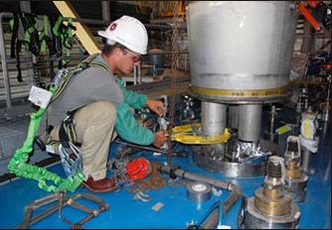
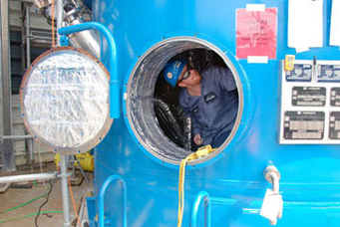
Is it Maintenance or Repair?
Distinction must be made because:
maintenance can be done under the direction of the System Owner
repairs (and alterations) must be directed by a Design Authority and must be done to ASME Code, National Standard or equivalent.

Slide 27
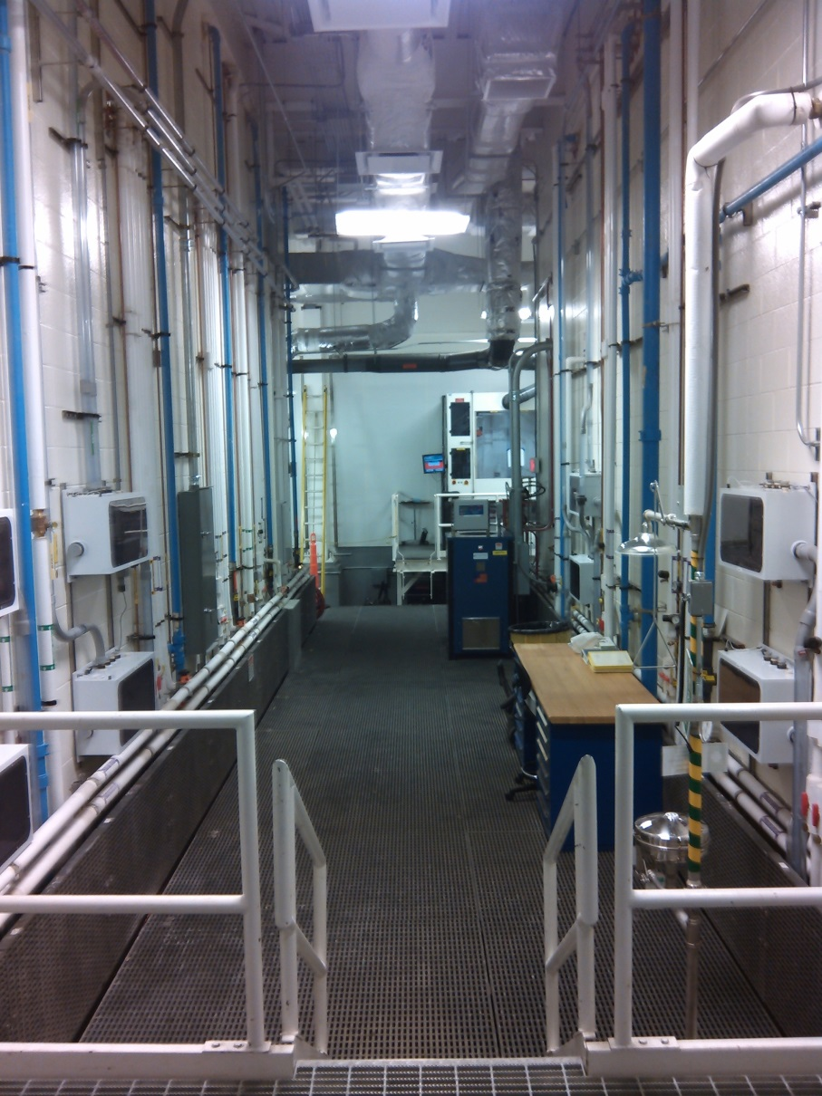
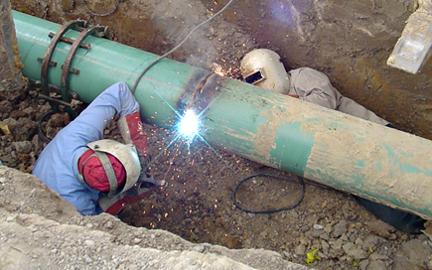
Is it Maintenance or Repair?
For a Category M System, maintenance where the pressure boundary is breached is a repair!
Maintenance on flammable fluid systems where the pressure boundary is breached or hot work is performed close to the pressure boundary is a repair!
Maintenance work that requires welding, grinding, cutting or brazing on the pressure boundary is a repair!
Category M - fluid so highly toxic that a single exposure to a very small quantity of the fluid, caused by leakage, can produce serious irreversible harm to persons on breathing or bodily contact, even when prompt restorative measures are taken (ASME B31.3)
Repairs must be under the direction of a Design Authority

Slide 28
Is it Maintenance or Repair?
Examples of Maintenance:
Cleaning
Painting and Corrosion Control
Oil Changes
Wear Pad Replacement
Valve Seal Replacement
Filter Cartridge Replacement
Pump Bearing Replacement
Support Hanger Spring Replacement
Support Roller Lubrication/Replacement

Slide 29
Is it Maintenance or Repair?
JLab has several shared pressure systems on site. Prior to tapping into or altering one of these shared systems, contact the overall System Owner and a Design Authority.
Shared System | System Owner
LCW | Carroll Jones x7672
Compressed Air | Carroll Jones x7672
Chilled Water | Carroll Jones x7672
Nitrogen Service | Carroll Jones x7672 *Nate Laverdure x6260
Helium Service | *Nate Laverdure x6260
*Nate is a contact and can identify the specific cryogenic System Owner

Slide 30
COURSE OVERVIEW
Introduction: Why Are We Here?
“Anatomy of a Disaster”
Safe Operation Techniques
Maintenance or Repair?
Safe Maintenance Techniques
Maintenance Lessons Learned
In-service Inspection Program
Wrap up / Where to Get Help

Slide 31
Safe Maintenance Techniques
Develop a maintenance plan
Use work planning/process tools
Follow depressurization/repressurization safe practices
Joint disassembly example
Train technicians for safe maintenance
Complete and store required documentation

Slide 32
Develop a Maintenance Plan
Safe Maintenance Techniques:
Take into account:
the system complexity
the system age and condition
the uses of the system
the environment
manufacturer’s instructions
previous history
Examples of Maintenance:
Cleaning
Painting and Corrosion Control
Oil Changes
Wear Pad Replacement
Valve Seal Replacement
Filter Cartridge Replacement
Pump Bearing Replacement
Support Hanger Spring Replacement
Support Roller Lubrication/Replacement

Slide 33
Safe Maintenance Techniques: Develop a Maintenance Plan
Who makes this plan?
Design Authority is responsible for defining special maintenance requirements for new systems
System Owner is responsible for defining the Maintenance Plan for their systems
In all cases, the System Owner is responsible for adapting the Maintenance Plan using operational experience as the system ages
Replacement intervals for thin windows
Replacement intervals for parts exposed to cyclic loading
Cathodic corrosion protection replacement
Special requirements defined by the DA
Maintaining integrity of vessel identification (phased-in)
Paint and basic corrosion control
Keeping relief device discharge paths clear
Manufacturer required equipment maintenance
Etc.

Slide 34
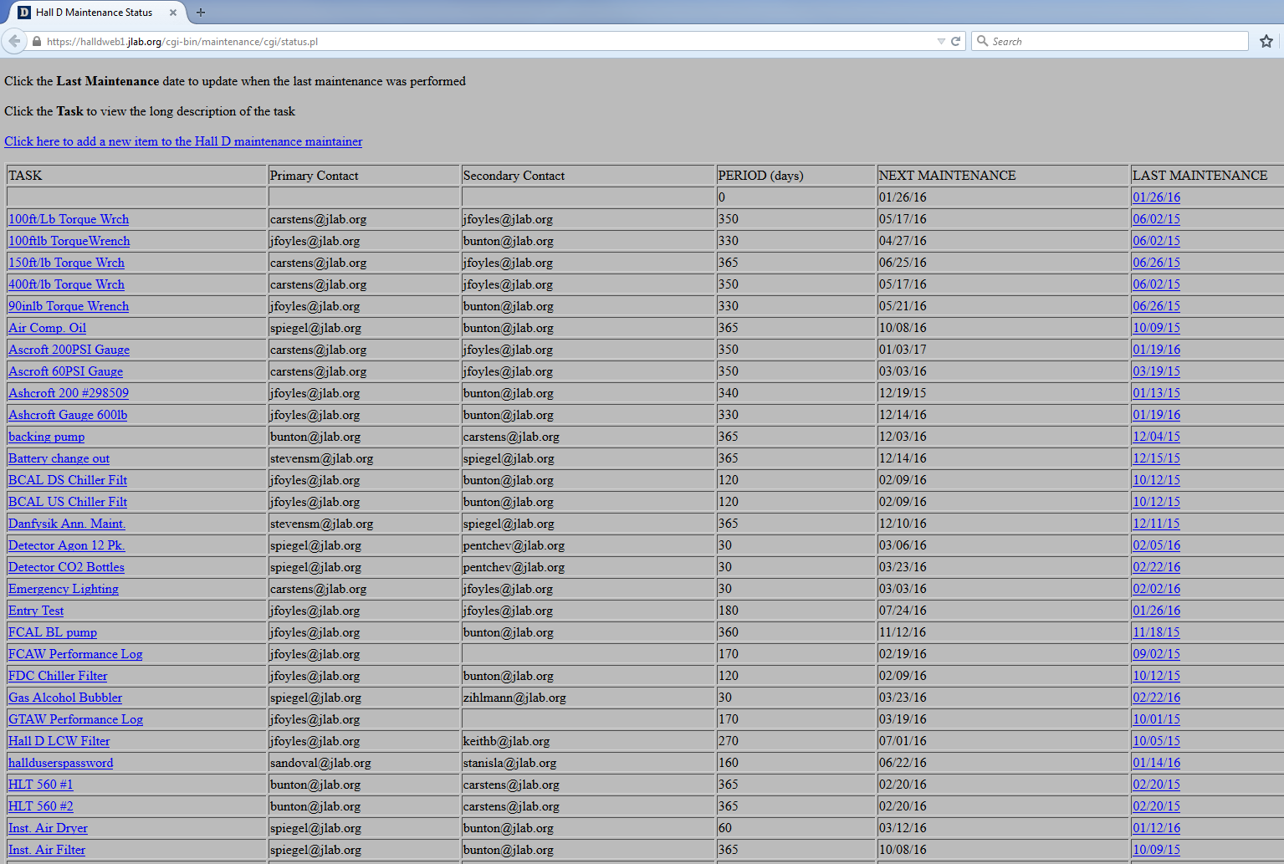
Safe Maintenance Techniques: Develop a Maintenance Plan
Who makes this plan?
Design Authority is responsible for defining special maintenance requirements for new systems
System Owner is responsible for defining the Maintenance Plan for their systems
In all cases, the System Owner is responsible for adapting the Maintenance Plan using operational experience as the system ages
What does this plan look like?
As varied as the pressure or vacuum systems on site

Slide 35
Safe Maintenance Techniques: Develop a Maintenance Plan
Replacing Pressure Relief Devices
Relief Devices with Set Pressure ≥ 15 psig
At replacement, use only ASME stamped devices
Register if protecting a vessel, Cat. M system or piping larger than 6 NPS (Form PS-5)
Relief Devices with Set Pressure < 15 psig*
Not required to meet ASME BPVC
Devices may be procured or manufactured, whole or in part, on or off site.
* Devices with set pressures < 30 psi, protecting vacuum jackets for cryo piping ≤ 6 NPS are also not required to meet ASME BPVC.
Procure from reputable manufacturers. Capacity and set pressure shall be per part replaced or engineering design.
JLab-made devices shall comply with Supplement

Slide 36
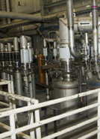
Use Work Planning/Process Tools
Safe Maintenance Techniques:
As required, standard work planning tools shall be written to ensure personnel and equipment safety:
THA
ATLis, etc.
TOSP/OSP
Desktop procedure
Ask yourself: “How could an accident happen?”
It could happen; find out how.
Beware of confirmation bias.
Just because it has been done one way for many years, doesn’t make it right.
Remember …
Even the simplest of tasks must be performed with caution

Slide 37
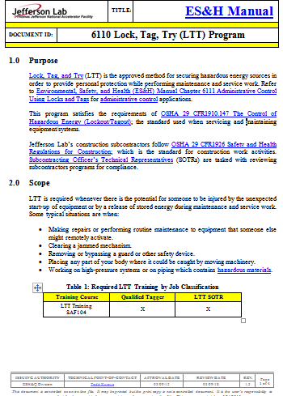
Depressurization/Repressurization Practices
Safe Maintenance Techniques:
A major maintenance concern is exposure to sudden release of stored energy or unexpected re-pressurization of a component.
Best practice when breaching the pressure boundary is to deenergize the entire system.
With shared systems this is impractical requiring isolation and deenergization of system legs or branches.

Slide 38
Safe Maintenance Techniques: Depressurization/Repressurization Practices
Depressurization must be under direct supervision of trained personnel (follow proper lock, tag and try procedures)
Remove source of pressure and ensure that source cannot be reconnected until all work is completed
Release stored pressure in the system in a safe manner (for example, open a vent valve)
Ensure that pressure can not re-accumulate (for example, check valves on sample points or test connections)
Install physical blocks, if needed, to prevent unexpected re-pressurization.
Verify the de-energized state prior to performing work

Slide 39
Safe Maintenance Techniques: Depressurization/Repressurization Practices
Repressurization must be under direct supervision of trained personnel (follow proper lock, tag and try procedures)
Integrity of reassembled components is untested until informal leak test is performed
Personnel not directly involved shall maintain a safe distance
Personnel performing the test shall stand at a safe distance (keeping arms and legs a safe distance) and inspect for leaks only after the system is stabilized

Slide 40
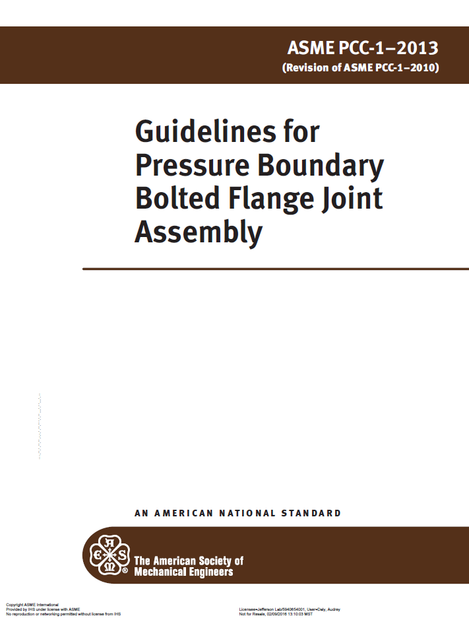
Joint Disassembly Example
Safe Maintenance Techniques:
AFTER VERIFICATION THAT ALL PRESSURE HAS BEEN REMOVED:
(use PCC-1 for guidance)
First bolts loosened on a flange should be in a location that will direct pressure release away from the worker
If a load control procedure is necessary, loosen bolts in a cross-pattern to approximately half initial preload
Check gap around the circumference after first cycle and selectively loosen bolts to achieve a reasonable uniform gap
Reaffirm that all pressure has been released and the joint has separated, proceed with bolt loosening and nut removal. A sufficient number of loosened nuts should be left in place until all tension has been relieved to guard against falling components, pipe spring or other unanticipated movement.

Slide 41
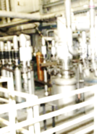
Train Technicians for Safe Maintenance
Safe Maintenance Techniques:
Training of technical staff shall be as required by the task and may include on-the-job training.
Maintenance work shall be completed by competent technical staff under the direction of the System Owner.
Technical Staff will typically be trained by the work supervisor. The System Owner can delegate this task but not the overall responsibility.
Maintenance work will most likely be performed under the direction of the work supervisor. The System Owner can delegate this task but not the overall responsibility.

Slide 42
Complete and Store Documentation
Safe Maintenance Techniques:
Documentation of maintenance activities is determined by the System Owner
It is recommended that documentation of maintenance activities be filed in a readily accessible manner such as an electronic maintenance database or logbook or the Pressure System project folder within the Pressure Systems database.

Slide 43
COURSE OVERVIEW
Introduction: Why Are We Here?
“Anatomy of a Disaster”
Safe Operation Techniques
Maintenance or Repair?
Safe Maintenance Techniques
Maintenance Lessons Learned
In-service Inspection Program
Wrap up / Where to Get Help

Slide 44
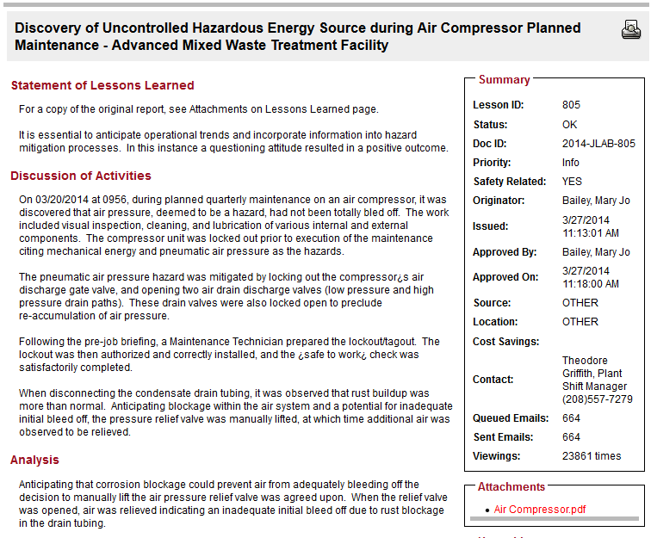
Maintenance Lessons Learned
“The lockout was then authorized and correctly installed, and the “safe to work” check was satisfactorily completed.”
“…it was observed that rust buildup was more than normal. Anticipating blockage … the pressure relief valve was manually lifted, at which time additional air was observed to be relieved.”

Slide 45
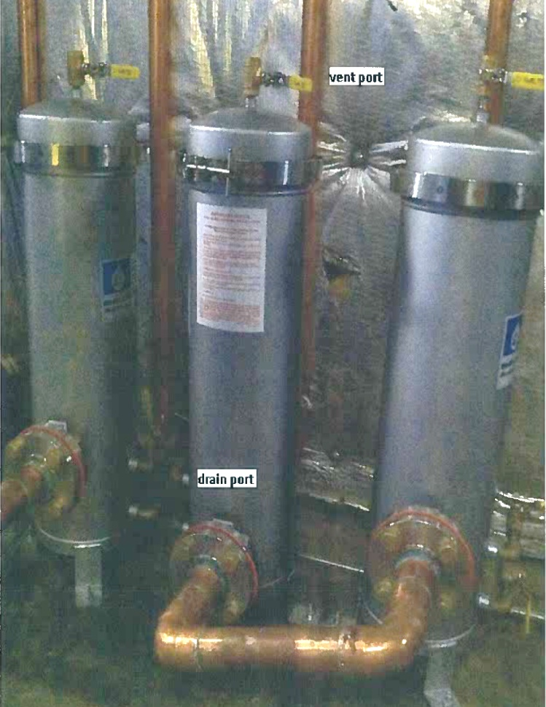
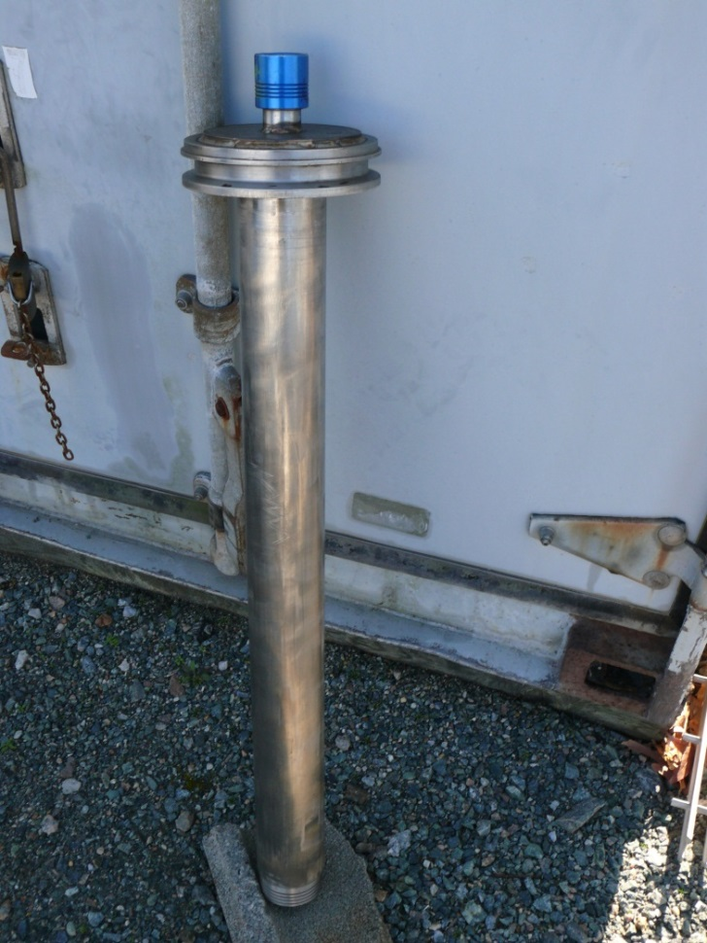
Maintenance Lessons Learned
08/15/2013 - Water filter housing ejected – severe injury to elbow
10/23/2013 - U-tube plug ejected during assembly of CHL1 – no
injuries but … a 25 lb slug of metal was launched 25 feet in the air
Ensure all workers have SAF130A.
Update ES&H Ch 6151 to define system owners and technicians
Proper work planning tools should highlight specific hazards
Shut-offs or gauges should be included to confirm presence of stored energy local to job task
Complex tasks require coordinated work plans with consideration of interruptions and task “creep”
10

Slide 46
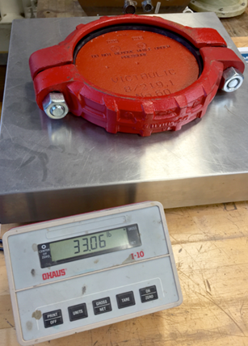
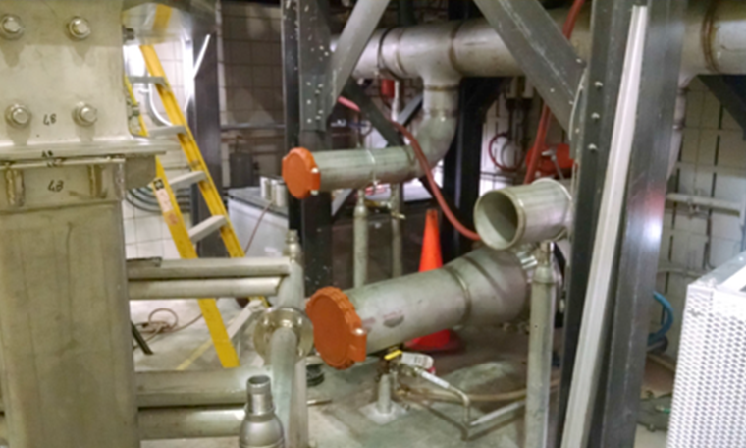
Recent Fatal Accident at FSU
FSU MagLab worker killed by pressurized cap on October 21, 2015
With a presumed valid lock-out in place, two workers were loosening the nuts on a Victaulic flange collar when an explosion occurred. The flange, the water behind the flange, or some combination of both, struck and propelled one mechanical technician backward and into the metal support structure for the cryostat, resulting in his death. The second technician,10 feet away at the time of the explosion, also was injured.

Slide 47
COURSE OVERVIEW
Introduction: Why Are We Here?
“Anatomy of a Disaster”
Safe Operation Techniques
Maintenance or Repair?
Safe Maintenance Techniques
Maintenance Lessons Learned
In-service Inspection Program
Wrap up / Where to Get Help

Slide 48
In-service Inspection Program
Define inspection category, type of inspection and interval
For Cat 4 and 3 - team up with Vessel Inspection Coordinator
For Relief Devices (Cat 4, 3 and 2) - team up with an In-service Inspector or PSC member
For Cat 1 Equipment - self inspect or team up with an In-service Inspector as required
Inspect and test pressure relief valves
Complete and store required documentation
Phased-in Implementation

Slide 49
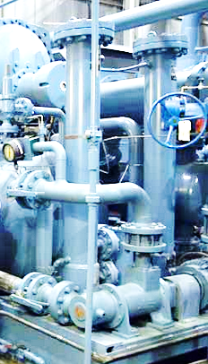
Define Category, Type and Interval
In-Service Inspection Program:
Inspection Categories
IC4: ASME stamped boilers and their relief devices
IC3: ASME stamped vessels and Cat M systems and their relief devices
IC2: Relief devices providing overpressure protection on Excluded Vessels or piping larger than 6 NPS
IC1: All other pressure equipment (piping, turbo and reciprocating machinery, non-ASME vessels, etc.)
Design Authority defines ISI requirements for new systems
System Owner defines ISI requirements for existing systems

Slide 50
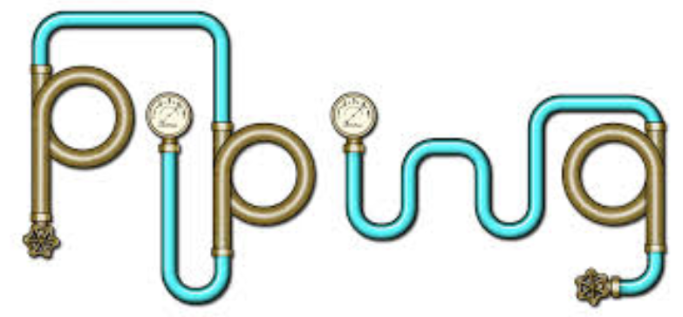
In-Service Inspection Program: Define Category, Type and Interval
Inspection Type
The inspector shall perform a visual inspection of vessels, piping, and ancillary equipment.
The inspector shall use sound engineering principles to determine if further inspection and examination techniques are required.
visual inspection

Slide 51
In-Service Inspection Program: Define Category, Type and Interval
Inspection and Testing Intervals
Determine the required inspection interval by considering the following:
Fatigue, vibration, and pressure pulsing
System fluid
Component materials
Environment in which the component is installed
The potential for rust, scale, or build-up
Other relevant factors determined by the System Owner/user or DA

Slide 52
In-Service Inspection Program: Define Category, Type and Interval
Inspection Interval (for IC4, IC3 and IC2)
IC4: ASME stamped boilers
and their relief devices
IC3: ASME stamped vessels
and Cat M systems and their
relief devices
IC2: Relief devices on Excluded
Vessels or piping >6 NPS
Component and Fluid Service | Maximum Test and or Inspection Interval (years)
Vessel: Gas (non-corrosive) | 5
Vessel: Gas (corrosive) | 2
Vessels and piping: Category M fluid | 1
Vessel: Liquid (corrosive) | 1
Vessel: Liquid (non-corrosive) | 5
Dewar Vessel | 2
Rupture Disk | Inspect/Replace every 5
Vessel: Boiler | 2
IC4 Relief Device | 2
Relief Device: Gas (non-corrosive) | 5
Relief Device: Gas (corrosive) | 2
Relief Device: Category M fluid | 1
Relief Device: Liquid (corrosive) | 2
Relief Device: Liquid (non-corrosive) | 5
Relief Device on Dewar Vessel | 5
Interval may be increased after suitable record of satisfactory inspections for equipment other than for ASME boilers and Cat. M systems.

Slide 53
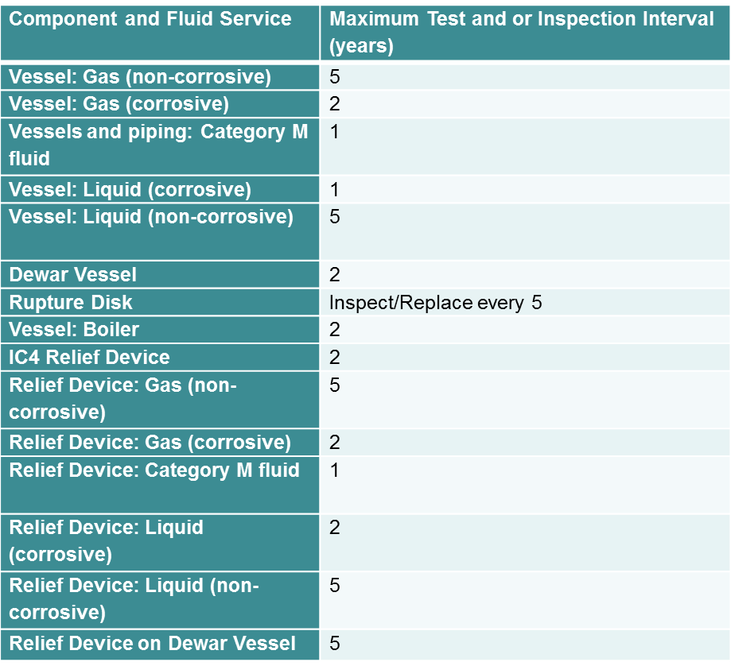
In-Service Inspection Program: Define Category, Type and Interval
Inspection Interval (for IC1)
For IC1 Components and
Systems [all other pressure equipment
(piping, turbo and reciprocating machinery,
non-ASME vessels, etc.)] only:
System Owners may use the
same table for guidance. These
specific intervals are not
required. However, an interval
must be defined and documented
for each system.

Slide 54
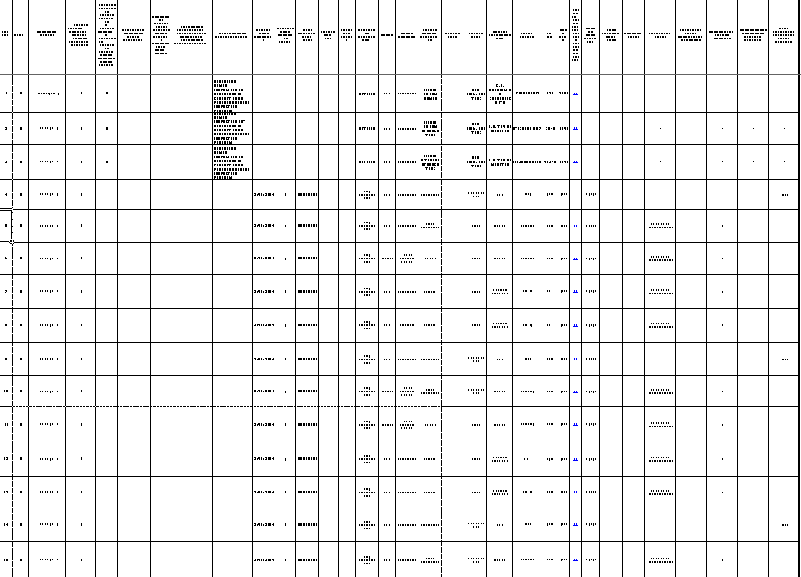
For Cat 4 and 3 - team up with Vessel Inspection Coordinator
In-Service Inspection Program:
Jenord maintains the inspection database of ASME boilers and pressure vessels and relief devices protecting them.
Jenord Alston x5859
He coordinates with outside inspectors to perform required inspections of ASME boilers/vessels /relief devices
He and the inspector complete Form PS-11. Jenord stores a copy of the most recent inspection.

Slide 55
For Relief Devices (Cat 4, 3 and 2) - team up with an In-Service Inspector or PSC member
In-Service Inspection Program:
System Owners must ensure that relief devices (Cat 4,3 and 2) are regularly tested and inspected. Tests and inspections shall be performed by qualified in-service inspectors. Right now help is available from the PSC.
Jenord Alston
x5859
Dave Meekins
x5434

Slide 56
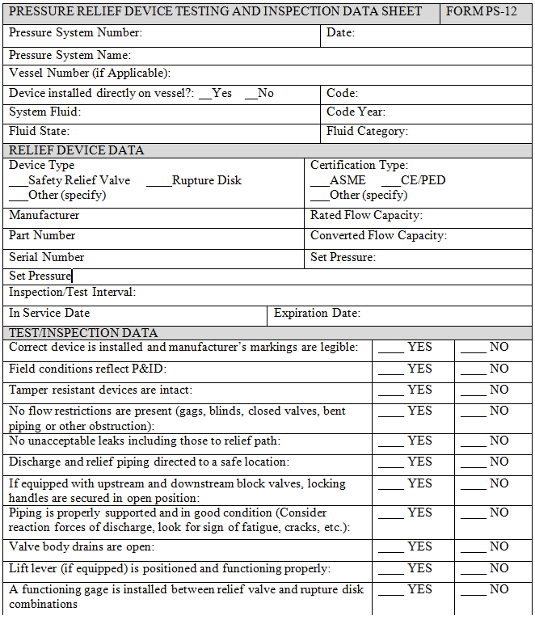
For Relief Devices (Cat 4, 3 and 2) - team up with an In-service Inspector or PSC member
In-Service Inspection Program:
Two basic types of tests and inspections:
In situ or field: may be as simple as lifting the actuator or involve closing block valves and checking the opening pressure. Perform only on systems known to be free of corrosion, scale, etc. that would impede valve operation.
Shop: involves detailed steps for removal, in-shop inspection and testing and reinstallation.
Detailed procedures for both are defined in Part 9, Section 3 Procedures for Inspection and Testing of Relief Devices.
Any ASME device failing inspection or test shall be sent to a qualified shop or tagged for disposal. At no point are JLab personnel to attempt a repair of an ASME relief device.
Form PS-12 must be completed and filed.

Slide 57
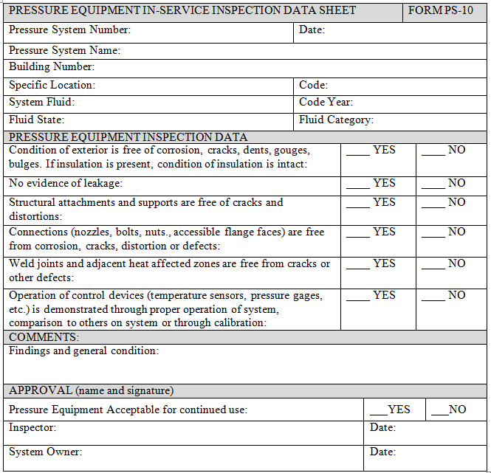
For Cat 1 Equipment - self inspect or team up with an In-service Inspector as required
In-Service Inspection Program:
System Owners must ensure that all pressure equipment not defined as Cat 4, 3 or 2 is regularly tested and inspected.
Need for In-service Inspector determined by System Owner
Perform visual inspection looking at:
overall condition
evidence of leakage
condition of connections, supports and weld joints
Review operation of control devices demonstrated through proper operation of system, comparison to others on system or through calibration
Complete and file Form PS-10 and/or PS-12

Slide 58
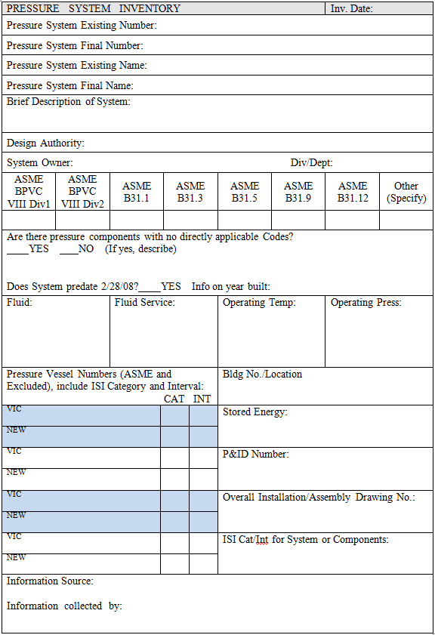
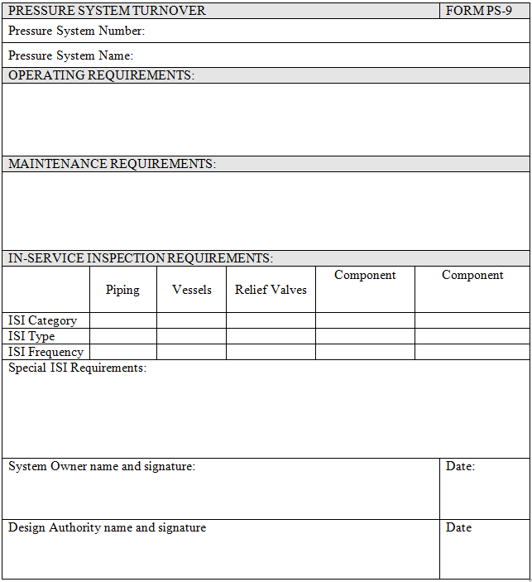
Complete and Store Documentation
In-Service Inspection Program:
The System Owner ensures that pressure systems and equipment are designated with an In-Service Inspection Category, Inspection Type and Interval:
New systems will document this information through Form PS-9 with the DA
Existing systems will document this information with the PS Inventory Task Group on their PS Inventory Sheet
The Vessel Inspection Coordinator shall store Form PS-11 for ASME boilers, vessels and visual inspection of their relief valves
System Owner is responsible to store forms PS-10 and PS-12 for each system or device inspected.

Slide 59
COURSE OVERVIEW
Introduction: Why Are We Here?
“Anatomy of a Disaster”
Safe Operation Techniques
Maintenance or Repair?
Safe Maintenance Techniques
Maintenance Lessons Learned
In-service Inspection Program
Wrap up / Where to Get Help

Slide 60
Wrap Up
“…years in the making but it was by no means inevitable”
Personal vs Process Safety
Reporting Events and Making Corrective Actions
Antiquated Designs
Siting of Employees
Human Factors
Not following procedures
Instrumentation not correct
Miscommunication
Poor training
Staffing limitations
Employee fatigue
Follow updated procedures
Use valid instrumentation
Clearly communicate
Train/retrain as needed
Provide adequate staff
Mitigate employee fatigue

Slide 61
Wrap Up
Responsibilities of the System Owner:
Pre-Operation
If required, works with Design Authority to ensure system requirements are defined.
After completion of the Final System Walkthrough, officially accepts responsibility of the pressure system through a System Turnover documented by Form PS-9.

Slide 62
Wrap Up
Responsibilities of the System Owner: (cont.)
Operation and Maintenance
Ensures that their systems are maintained and operated by qualified personnel.
Ensures that their systems continue to be maintained and operated in a safe manner compliant with this Supplement.
Notifies PSC Designee (Audrey Barron) if a system is taken out of operation permanently or if system ownership changes.
Develops operational procedures and maintenance plans as necessary.
Maintains the integrity and placement of vessel identification. (phased-in)

Slide 63
Wrap Up
Responsibilities of the System Owner: (cont.)
In-Service Inspection
Ensures that their systems are inspected and/or tested in compliance with this Supplement.
Works with the VIC to complete in-service inspections of IC4 and IC3 systems.
Notifies VIC of a change in status of IC4 or IC3 pressure vessels or relief devices such as “Removed from Service”, relocation, or changes in operational parameters.
When notified by the VIC of a condemned vessel, removes the vessel from service as soon as safely possible.
Phased-in Implementation

Slide 64
Wrap Up
Responsibilities of the System Owner: (cont.)
In-Service Inspection (cont.)
Ensures that in-service inspections of IC2 and IC1 systems are completed and documented.
Maintains test and inspection records of relief devices.
Ensures that corrective action is taken when notified of deficient relief devices.
Phased-in Implementation

Slide 65
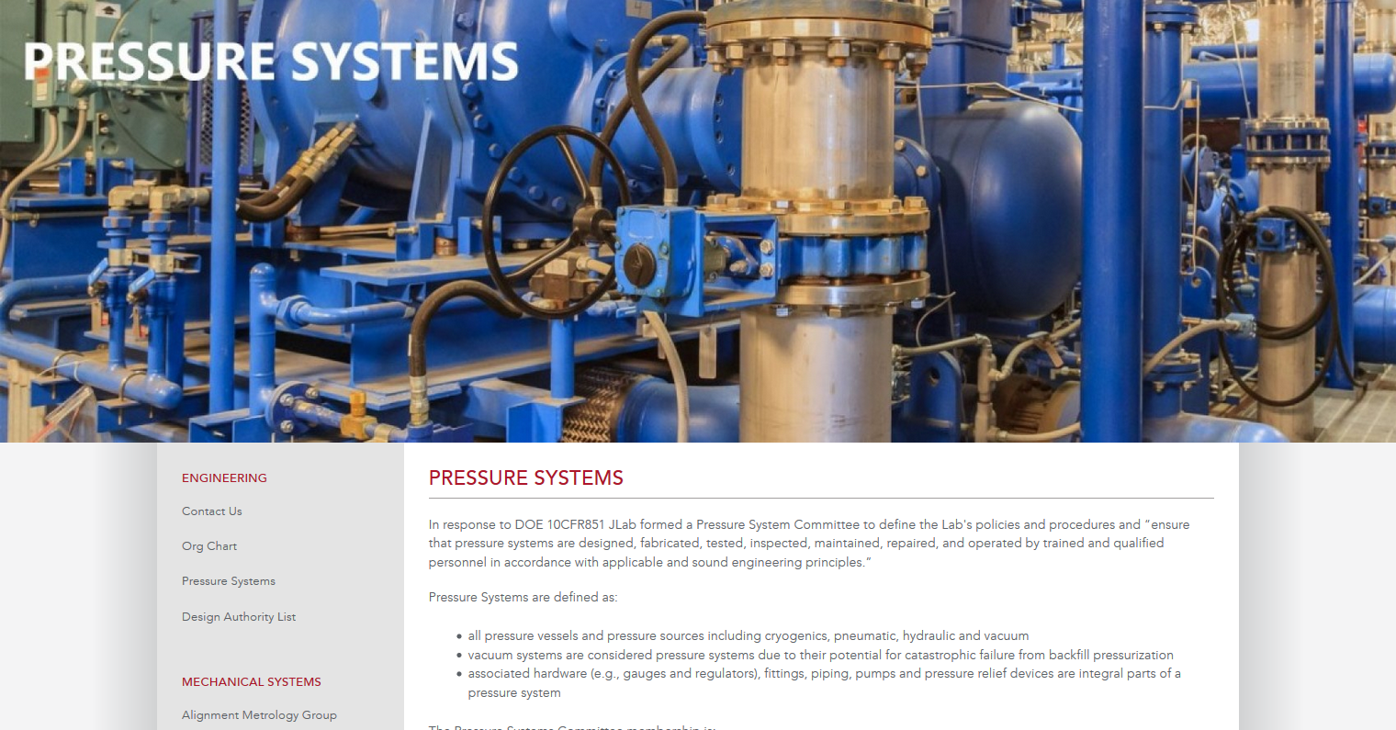
Wrap Up
Pressure Systems Webpage (Site Index under P)

Slide 66
Where to Get Help
Pressure Systems Committee
Dave Meekins (Chair), Jenord Alston, Chad Bailey, Jacob Harris, Carroll Jones, Joseph Lamont, Nate Laverdure, Steve Smith, Tim Whitlatch,
Audrey Barron (x7327)

